Slide 1
Time Series of
Infant Mortality Rates
UC Santa Barbara
PSTAT 174
Elizabeth Wang, Maddie Reiff, Kevin Zhang, Tatiana Shahinian, Hai Nguyen

Slide 2

Introduction
Humans have made critical advances in the last century to reduce the mortality rate.
Dataset summarizes the decreasing trend of mortality rates throughout the 20th to 21st century.
Goal of the report:
To determine whether he decreasing trend will decrease at a significant or gradual rate.
To predict the prospective rates for the next ten years.
Hypothesis: There are setbacks that prevent the infant mortality rate from being even lower.
Notes:
Advances in medicine, better nutritional practices, environmental regulations, access to healthcare and vaccinations, and professionalism in surgical practices, have reduced infant mortality rates.
It is important for us to examine the trend of infant mortality rates.

Slide 3
Objectives
Project Summary:
Finding the optimal lambda through the Box Cox test.
Differencing n number of times before overdifferencing. (n + 1 = overdifferenced)
Analyzing detrended and stationary ACF and PACF to estimate p and q values or ARIMA model.
Diagnostic methods include histogram and QQ plot analysis Shapiro Wilk , Ljung Box, and Box Pierce tests.
Forecasting next 10 values

Slide 4
DATA ANALYSIS

Slide 5
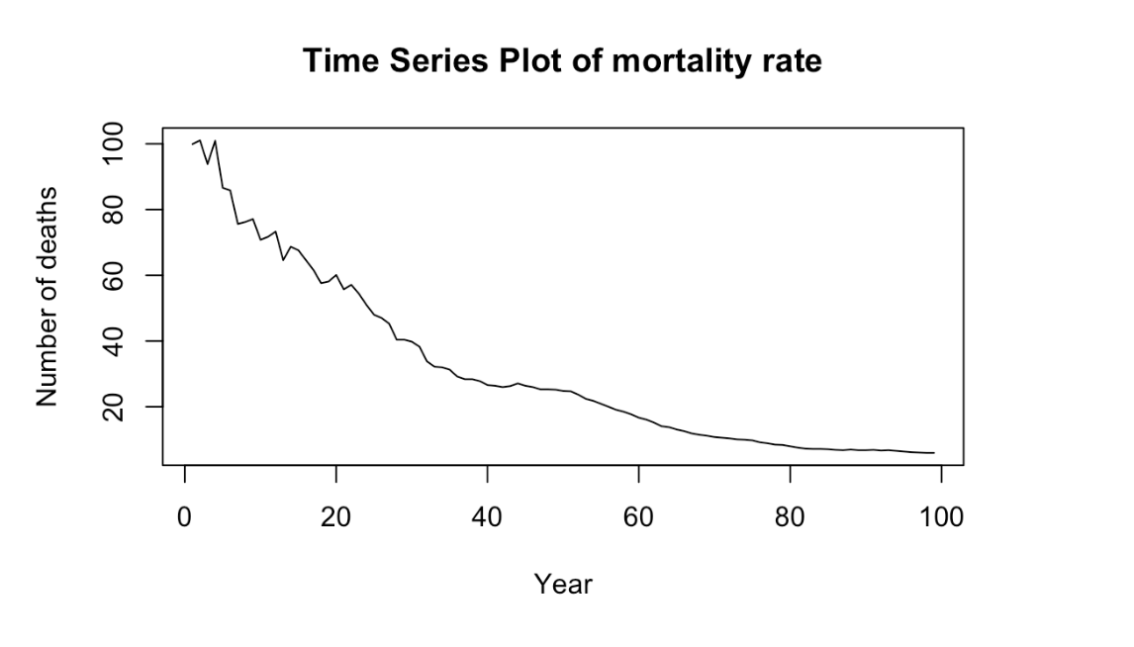
Time Series Analysis
Upon plotting our time series, it is evident that there is a non-linear downward trend, and non-constant variance.
It is non seasonal because the patterns of variance are not consistent.
Also note how the time series initially jumps up and down in a spiky pattern, and eventually smooths out.

Slide 6
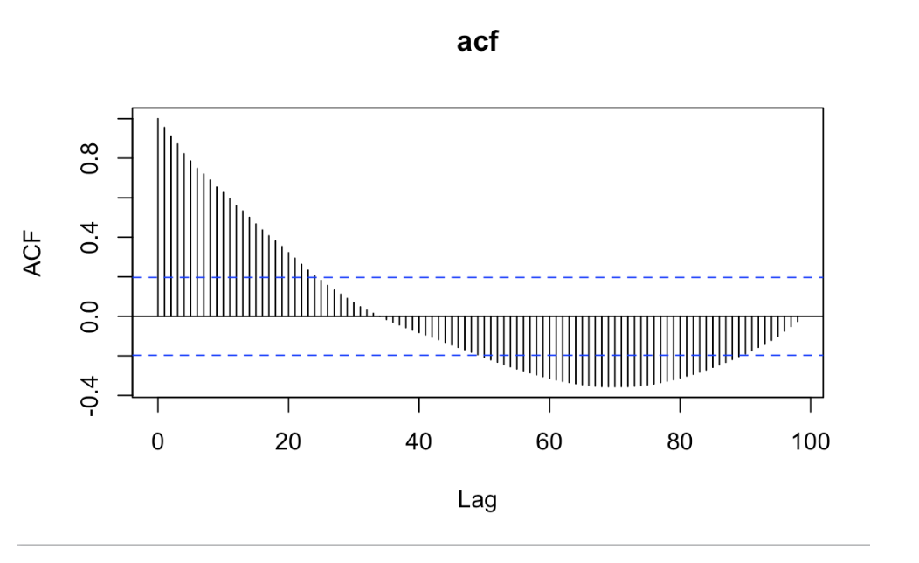
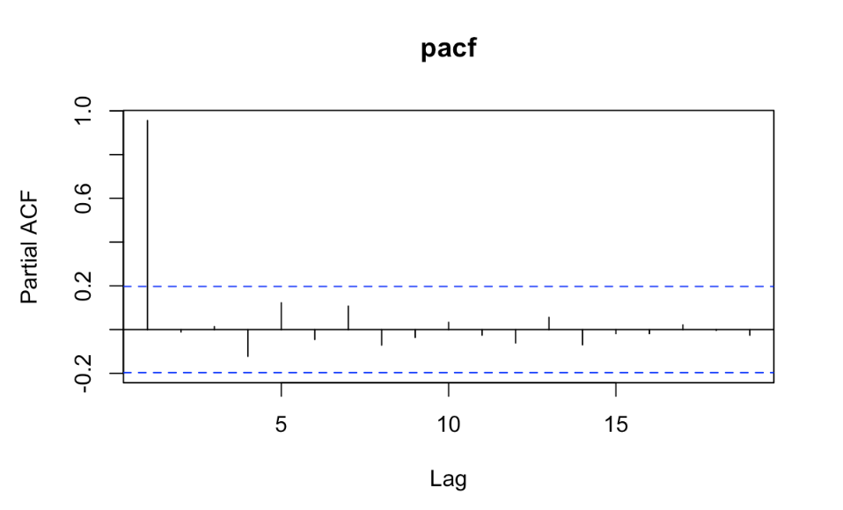
ACF and PACF Analysis
Notes:
The initial ACF plot (figure below) gradually decreases and takes awhile to reach the confidence bounds.
It continues its pattern within the confidence bounds and leaves them again at around lags 50-90.
While the ACF plot decays sinusoidally,The PACF cuts off after lag 1. Since the ACF tails off and the PACF cuts off after lag 1, we can initially label our model as AR(1).
Since the time series series has positive autocorrelations out to a high number or lag, specifically up to about lag=21-22, then we conclude that differencing is necessary for our data.

Slide 7

Transformed Data Analysis
After analyzing the initial time series plot, it is evident that the plot is not stationary and must be transformed in order to remedy the trend and non-constant variance.
Using Box-Cox transformation to determine the appropriate transformation for our time series.
Notes:
We found a lambda value to be approximately 0, which told us to take a log transformation.

Slide 8
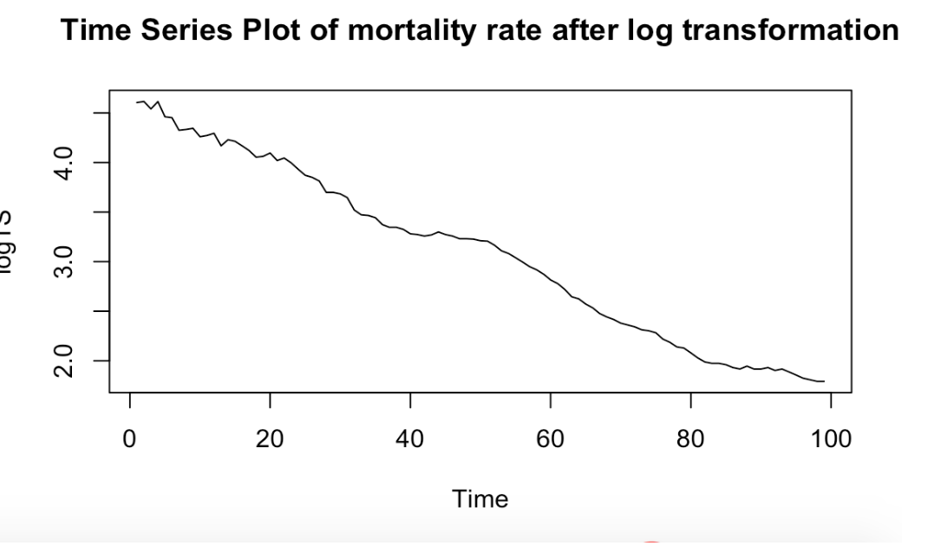
Transformed Data Analysis
Differencing the log transformed data once to remove the downward trend.
Before transformations and differencing vs. after log transformation. BEFORE AFTER
Notes:
After the log transform: eliminated some of the non-linear trend, decreased the size of spikes, and made the variance more constant than before

Slide 9
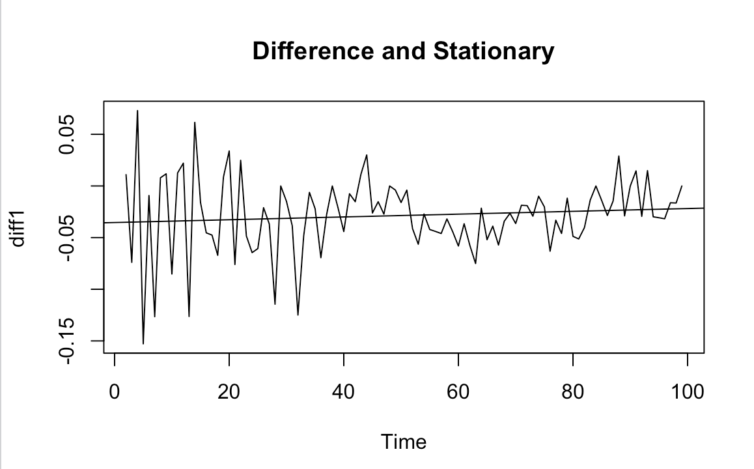
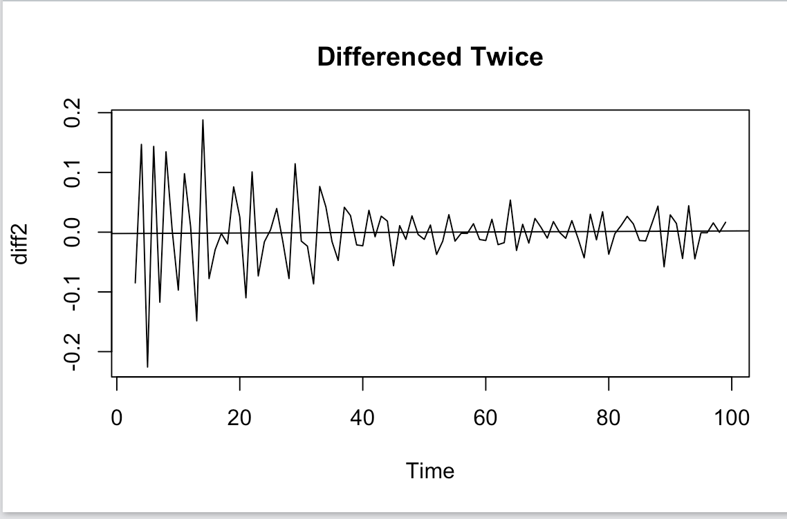
Differencing
Variance before differencing: var(mortalityTS) = 692.3877
Variance after 1st differencing:
diff1← diff(logTS, lag = 1)
var(diff1) = 0.001380228
Variance after 2nd differencing:
diff2← diff(diff1, lag=1)
var(diff2) = 0.003438241
Notes:
We can see that the variance of the 2nd difference has increased (0.001380228 to 0.003438241). Moreover, we can observe that at lag-1, the ACF is more than -0.5, which indicates that we have overdifferenced. Therefore we will sick with the first difference.
Increased variance when differenced twice

Slide 10
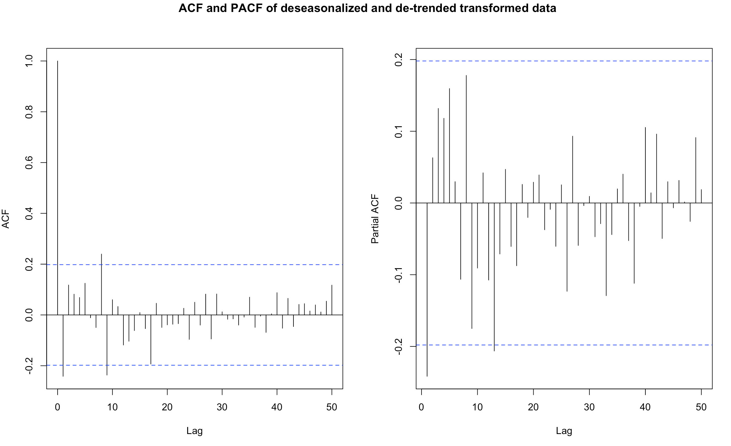
ACF and PACF of Transformed Plot
PACF cuts off after lag 1,
ACF also cuts off after lag = 1.
Implying that the differenced model could be AR(1) or MA(1).
Notes:
Both ACF and PACF are decaying, just not gradually, so it has a slim chance of being an ARMA(1,1) model

Slide 11
MODEL FITTING

Slide 12
Initial Model Selection
Differenced model contained characteristics of an ARIMA(p,d,q) model where max(p,q) = 1 and d = 1.
Thus, the original model will be an ARIMA(p,1,q) after differenced once to remove trend.
Therefore, we have the following models:
Model 1: ARIMA(1,1,0)
Model 2: ARIMA(0,1,1)
Model 3: ARIMA(1,1,1)
Model 4: ARIMA(0,1,0)
Notes:
Based off of the transformed ACF and PACF plots, we came to the conclusion that our differenced model contained characteristics of an ARMA(p,q) model where max(p,q) = 1.
Therefore, we proceeded to test the following ARIMA(p,1,q) models with p and q being different combinations of 0 and 1.

Slide 13
AIC Analysis
Model 1: ARIMA(1,1,0)
AIC = -368.22
Model 2: ARIMA(0,1,1)
AIC = -367.08
Model 3: ARIMA(1,1,1)
AIC = -366.44
Model 4: ARIMA(0,1,0)
AIC = -364.27
Model 1 and 2 have the lowest AIC values, implying they are the best models to use.
Notes:
The two models we compared were Model 1: ARIMA(1,1,0) and Model 2: ARIMA(0,1,1). We used a Maximum Likelihood Estimation technique to determine the parameters of each model.

Slide 14
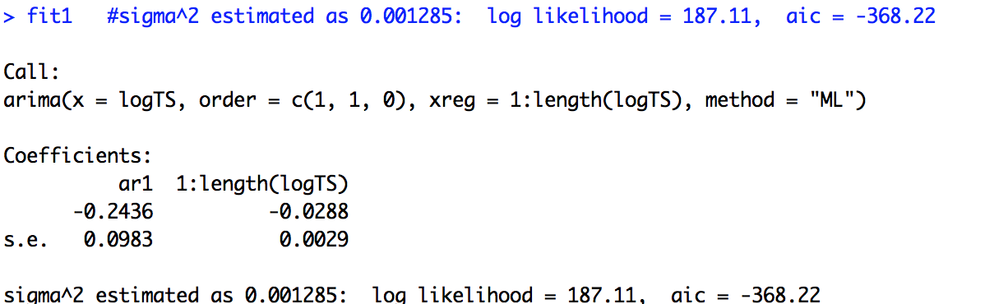
Parameter Estimation
Model 1: An ARIMA(1,1,0) series with drift can be modeled as Y_{t} = c + 𝝓Y_{t- 1} + ɛ_{t} where c is the drift constant.
Y_{t} = -0.0288 - 0.2436Y_{t- 1} + ɛ_{t}

Slide 15
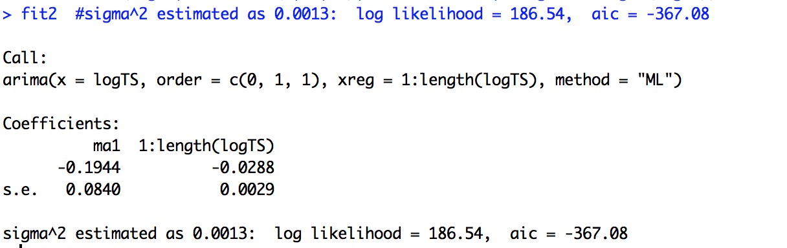
Parameter Estimation
Model 2: X_{t}= -0.0288 + Z_{t}- 0.1944Z_{t- 1}

Slide 16
DIAGNOSTICS

Slide 17
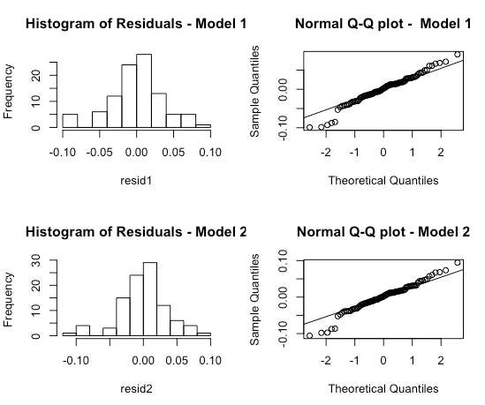
Histogram and QQ Plot Analysis
Model 1 and Model 2 appear to be approximately normal
The models may or may not pass the normality test by a margin.
Notes:
-Both plots appear to show normality
-Outliers on the ends of the histogram and QQ plot, so may not be perfectly normal

Slide 18
Shapiro Wilk Test
H₀ = Model follows a normal distribution
H₁ = Model does not follow a normal distribution
P-values:
Model 1: 0.02945
Model 2: 0.01647
Could be better, neither Model 1 nor Model 2 passed normality conditions at 95% confidence, but Model 1 is definitely closer to p value=0.05.
Notes:
-Test for normality
-Reject null hypothesis
-Conclude that both models don’t follow normal distribution
-Affected by the outliers
-P-values are large enough that we can overlook this test and still assume normality
-Model 1 has larger p-value so is better

Slide 19
Ljung-Box Test
H₀ = residuals are serially uncorrelated
H₁ = residuals are serially correlated
P-values:
Model 1: 0.6076
Model 2: 0.5991
Both passed the test, so neither Model 1 nor Model 2 are serially correlated!
Notes:
-Test for autocorrelation within residuals
-Fail to reject null hypothesis
-Conclude residuals are serially uncorrelated
-Model 1 has larger p-value so is better

Slide 20
Box-Pierce Test
H₀ = residuals are serially uncorrelated
H₁ = residuals are serially correlated
P-values:
Model 1: 0.9259
Model 2: 0.9191
Both passed the test, so neither Model 1 nor Model 2 are serially correlated!
Notes:
-Test for autocorrelation within residuals
-Fail to reject null hypothesis
-Conclude residuals are serially uncorrelated
-Model 1 has larger p-value so is better

Slide 21
FINAL MODEL

Slide 22
Final Model Conclusion
Model 1 is our best fit model!
Data follows an ARIMA(1,1,0) model
Algebraic formula: Y_{t} = -0.0288 -0.2436Y_{t-1}+ ɛ_{t}
Notes:
-Model corresponds with what was suggested with the ACF and PACF
-No heteroscedasticity after the diagnostic checks

Slide 23
FORECASTING

Slide 24
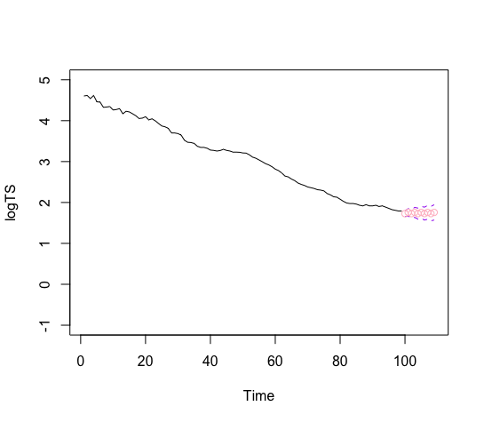
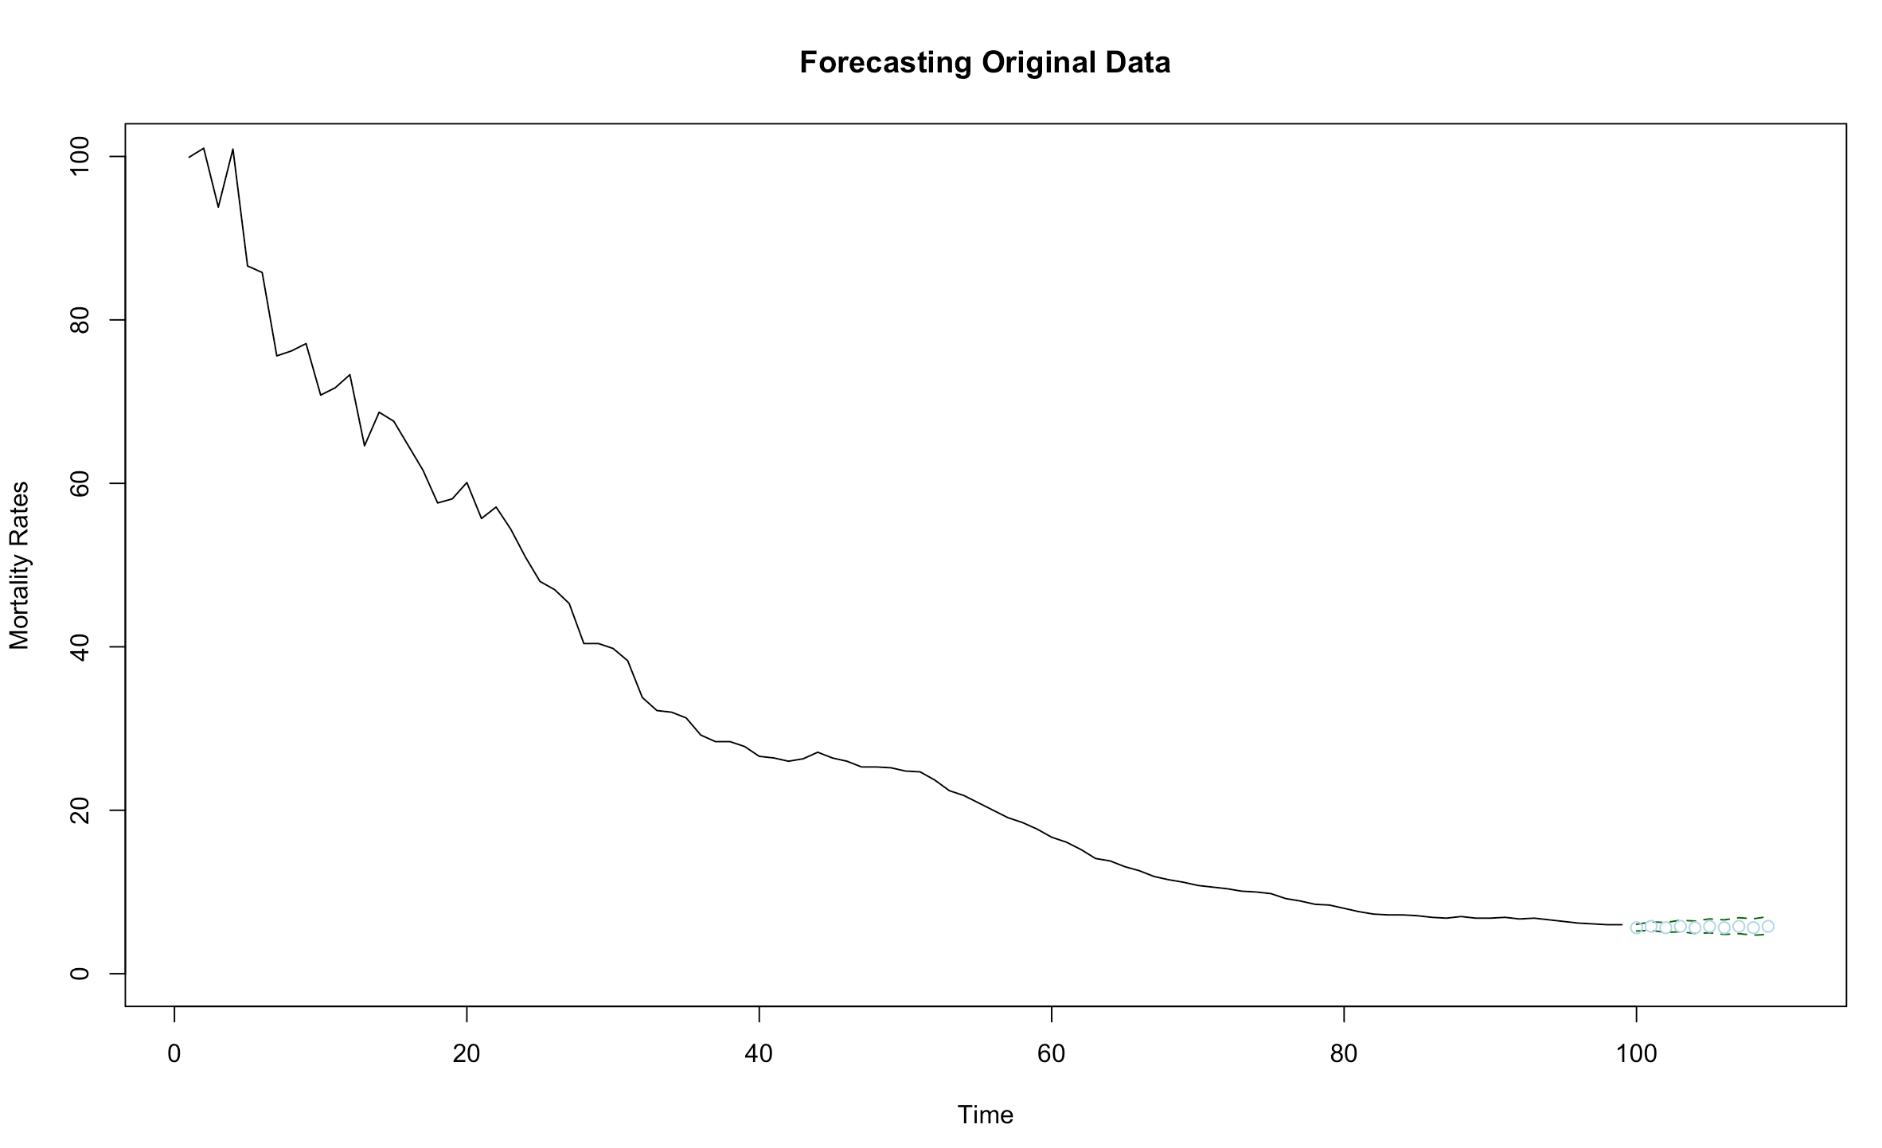
Graph on the left is 10 forecasted values of our log transformed time series, while the one on the right is the 10 forecasted values of our original data.
Our forecasting generally verified our hypothesis that infant mortality rates are decreasing, but eventually plateauing to a consistent slope near zero.

Slide 25
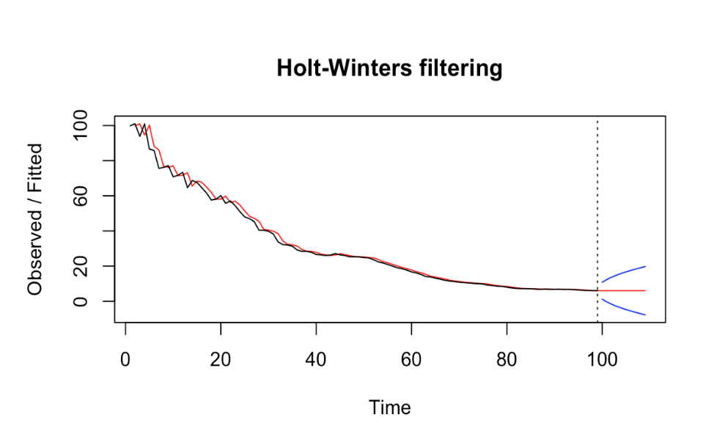
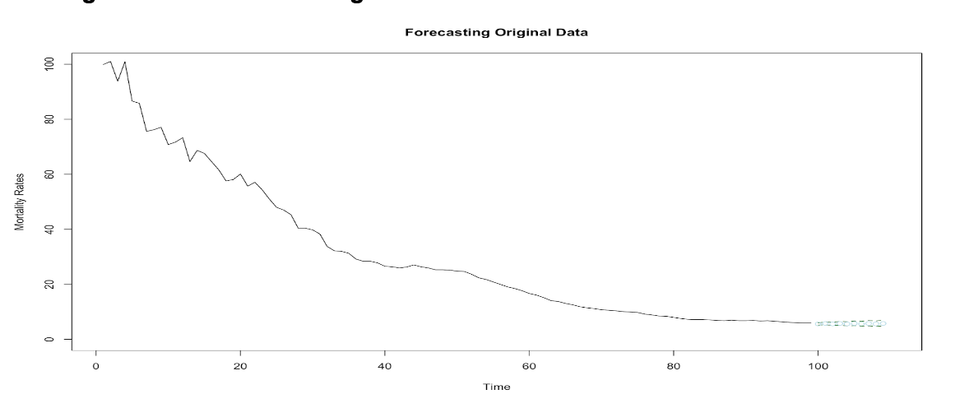
Holt-Winters Forecasting
Optional method that I (Elizabeth) used to prove that even without fitting our chosen model on the original data, we can show that the next ten forecasted values are approximately identical to our derived forecast (with model one). The Holt Winter forecasting auto generated the next 10 forecasted values for us, as you can see below:

Slide 26
CONCLUSION

Slide 27

The final equation:
Infant mortality rates are generally decreasing, but like we predicted, there is a plateauing trend of the next ten years, as shown a minimal negative slope close to zero.
Our hypothesis is definitely proven to be true or significant on some level.
Why is our hypothesis valid?
Maternity or health related risks, socio economic and political issues such as affordability problems, inability to access abortion clinics, competition in the market making it harder for innovation.
Notes:
ON THE BRIGHTER SIDE!!!….. We are reassured that infant mortality rates are significantly lower than they are in other countries, and thus demonstrate that the United States have made many unparallel advancements in healthcare.

Slide 28
References

Slide 29
References
Data used for project: https://catalog.data.gov/dataset/infant-and-neonatal-mortality-rates-united-states-1915-2013
Summary of rules for identifying ARIMA models. (n.d.). Retrieved December 5, 2018, from https://people.duke.edu/~rnau/arimrule.htm
Achievements in Public Health, 1900-1999: Healthier Mothers and Babies. (n.d.). Retrieved December 5, 2018, from https://www.cdc.gov/mmwr/preview/mmwrhtml/mm4838a2.htm

